Slide 1
Development of a Responsive E-commerce Web Page
Case Study of a Perfume Store
Presented by: Nishat Jafri(24MCA20386)
& Aisha Zafri(24MCA20385)

Slide 2
Introduction
1.Importance of Online Presence
Changing Consumer Behavior:-Growing preference for online shopping.
Competitive Landscape:-A strong online presence is essential for attracting customers.
2.Project Overview
Objective:-Develop a user-friendly web page for a perfume store.
3.Focus Areas:
Aesthetics:-Use vibrant colors and high-quality images.
Functionality:-Ensure seamless navigation and efficient shopping.
Responsiveness:-Adapt design for desktops, tablets, and smartphones.
4.Goals:
-Enhance user experience and reflect brand identity.
-Leverage modern web technologies for optimal performance.

Slide 3
Key Features of the Web Page
1. User-Friendly Interface
Intuitive navigation with clear categories like "New Arrivals" and "Best Sellers."
2. Responsive Design
Adapts seamlessly to different devices (desktop, tablet, mobile) for consistent user experience.
3. Search Functionality
Prominently placed search bar with autocomplete suggestions for quick product access.

Slide 4
Additional Features
1. Product Showcase
High-resolution images and detailed descriptions to enhance product appeal.
2. Shopping Cart Integration
Easy-to-use cart for adding, modifying, and removing items, with transparent pricing.
3. Customer Account Creation
Allows users to track orders, view purchase history, and save preferences for a personalized experience.

Slide 5
Technological Implementation
1. HTML/CSS
HTML: Structure and organize content.
CSS: Enhance visual design with colors, fonts, and layouts.
2. JavaScript
Adds interactivity, such as dynamic shopping cart updates and form validations.

Slide 6
Technological Implementation
3. Responsive Frameworks
Utilizes frameworks like Bootstrap for flexible, adaptive layouts across devices.
4. Image Optimization
Compresses images to improve loading speed without sacrificing quality.
5. Accessibility Features
Includes alt text for images and semantic HTML for better navigation by assistive technologies.

Slide 7
Limitations Encountered
1. Browser Compatibility
Variability in how browsers interpret HTML/CSS, requiring extensive testing.
2. Performance Issues
Initial slow loading times due to unoptimized images and scripts; improvements were made through optimization techniques.

Slide 8
Limitations Encountered
3. User Testing Challenges
Limited formal testing led to potential usability issues; feedback mostly from informal channels.
4. Integration Challenges
Difficulties with third-party payment and analytics integrations due to compatibility issues.
5. Mobile Optimization
Some interactive elements required adjustments for optimal use on mobile devices.

Slide 9
Future Developments
1. Enhanced User Testing
Implement structured testing sessions for comprehensive user feedback.
2. SEO Optimization
Develop a strategy for improved visibility through on-page and off-page SEO techniques.

Slide 10
Future Developments
3. Expanded Features
Introduce wish lists, product reviews, and personalized recommendations to enhance user engagement.
4. Performance Enhancements
Conduct regular audits and optimizations to improve loading times and overall performance.
5. AI Integration
Explore AI-driven chat support and personalized shopping experiences to enhance customer service.

Slide 11
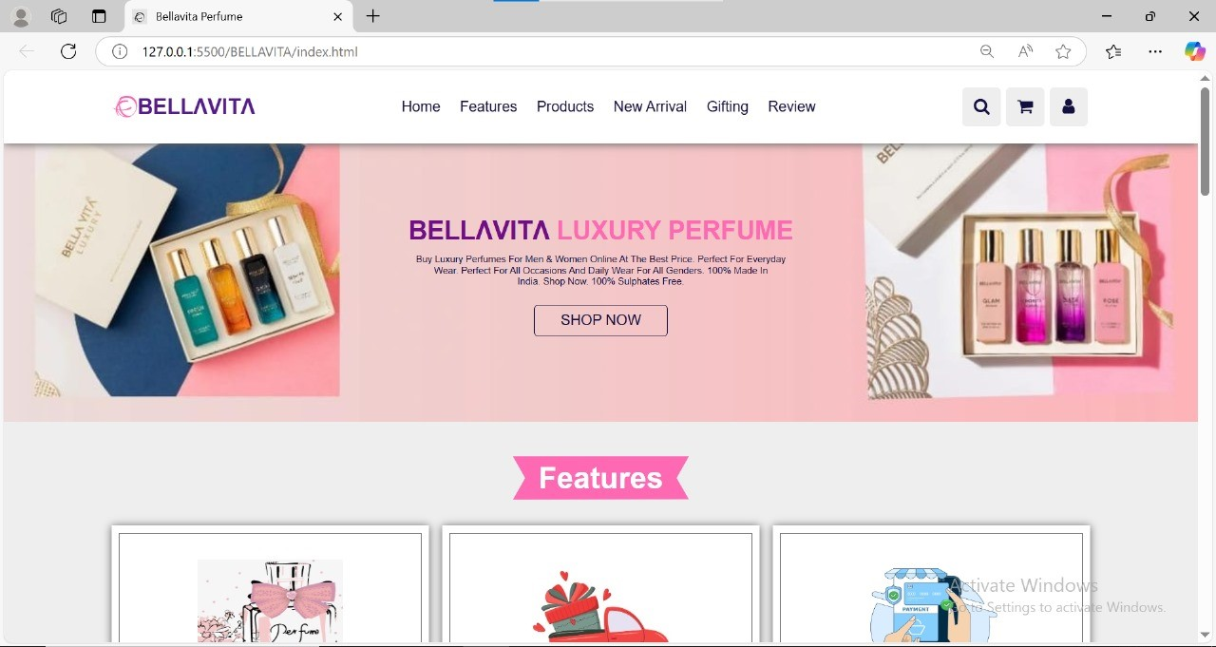
Visuals of the Project
Screenshots
Home Page: Showcases featured products

Slide 12
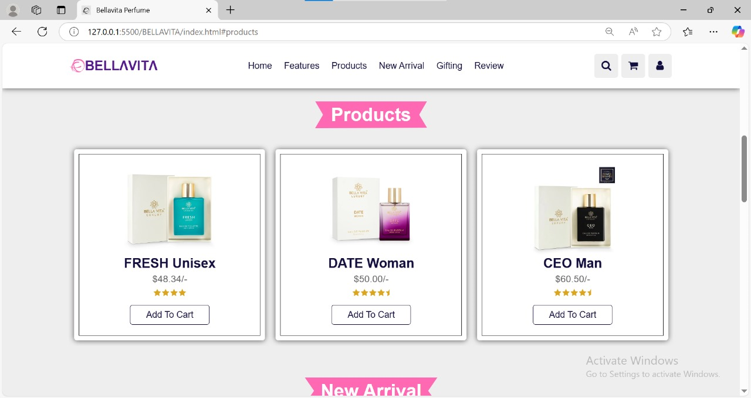
Visuals of the Project
Product Slider: User-friendly browsing

Slide 13
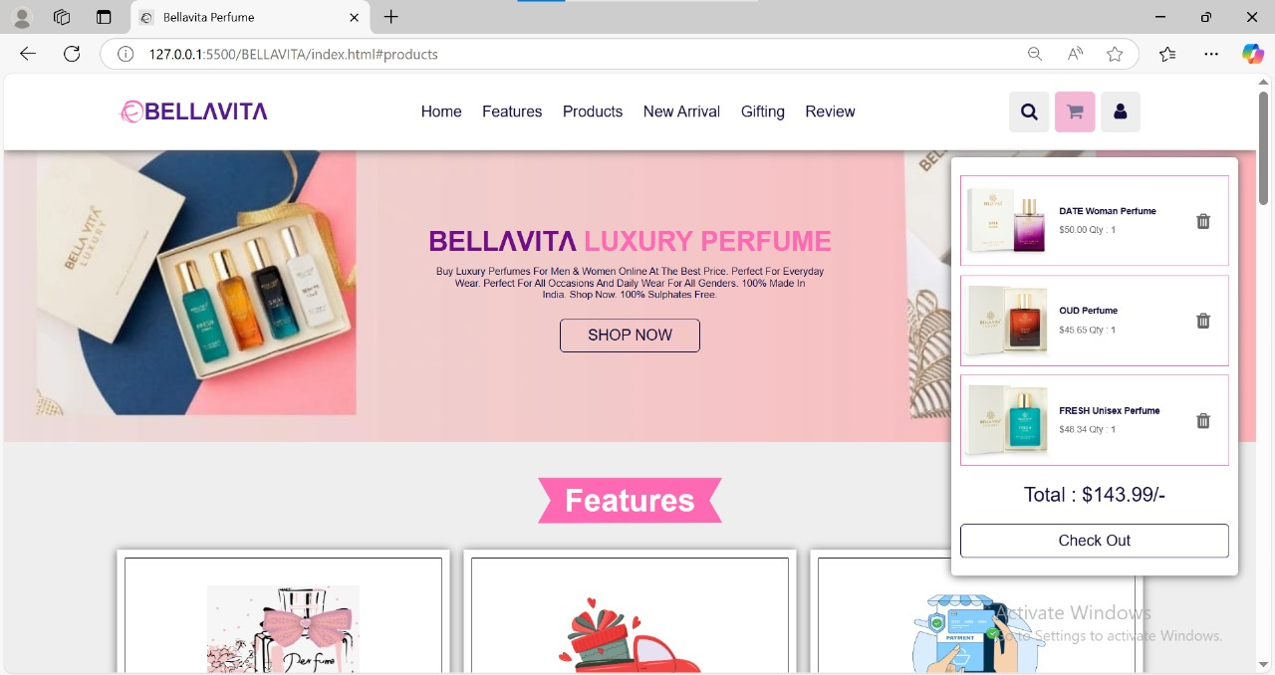
Visuals of the Project
Shopping Cart: Overview of selected items

Slide 14
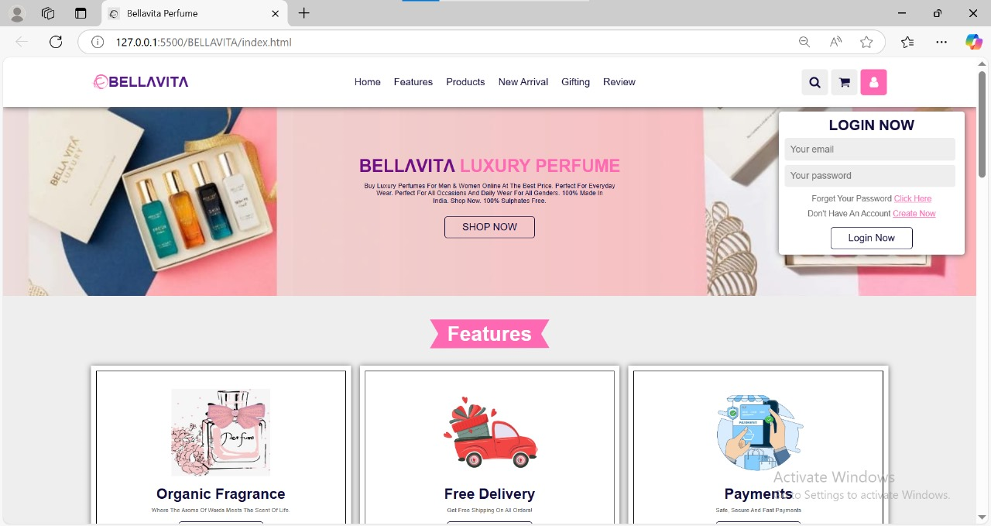
Visuals of the Project
Login Form: Simplified user access

Slide 15
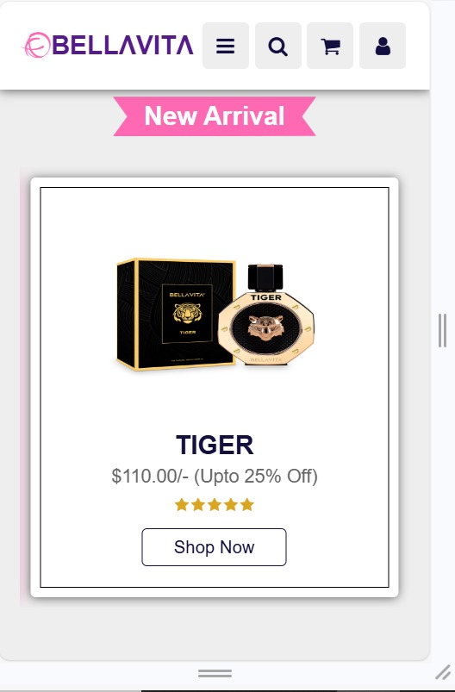
Visuals of the Project
Mobile View: Responsive design in action

Slide 16
Conclusion
Key Insights
A well-designed online presence is crucial for modern retailers.
Prioritizing user experience, aesthetics, and technology fosters customer engagement.
Importance for Future Projects
Emphasizes the need for thorough testing, effective integrations, and ongoing performance optimizations.
Highlights the value of adapting to user needs and market trends for sustained success.
Final Thoughts
A compelling online platform enhances brand loyalty and competitiveness in the e-commerce landscape.

Slide 17
That’s all , thank you
.........................................................

